Slide 1
The strategy pattern

Slide 2
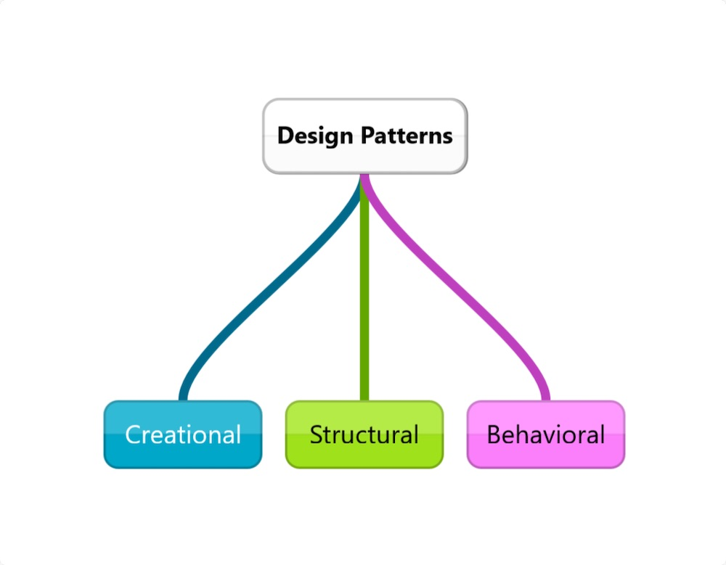
Introduction
Before diving into the strategy pattern, you should be familiar with some of the basics concepts of Object-Oriented Programming (OOP). The entire concept of design patterns revolves around classes and objects. The design patterns are more high-level solutions for commonly occurring problems. They are like the blueprint to solve a specific problem. They are not confined to a single programming language. You can use design patterns in any programming language that supports object-oriented programming; the process will be the same while the syntax changes.
Notes:
This is a straightforward solution for calculating the average of 2 numbers.
Notice the code in lines 3-5, repeated in lines 7-9.

Slide 3
There are several types of design patterns, including Creational, Structural, and Behavioral patterns. Creational patterns are about different ways to create objects that increase the flexibility of our code. Structural patterns are about relations between the objects, making larger structures flexible using objects and classes. Behavioral patterns are about effective communications and interactions between objects.
Notes:
This is a straight forward solution for calculating the average of 10 numbers.
Notice now the code in lines 4-6 repeated more than once (3 times to be exact).
In real life, the size of data that programs deal with, is generally huge.
For example:
Bank system calculations
Seeking information on the web.
Image processing
Network traffic monitoring
etc…
It would be impractical to repeat the same few commands dozens, or hundreds or thousands of times.
Programs would become unreadable, error-prone and hard to fix.
There must be another solution for the repetition-of-similar-or-same-code problem!

Slide 4
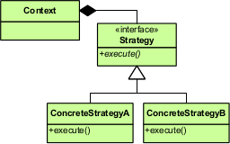
Strategy
Strategy Pattern is a design pattern that enables our application to select algorithms at runtime, making our application flexible. The original book on design patterns written by GoF states that "Strategy pattern intends to define a family of algorithms, encapsulates each one, and make them interchangeable." More specifically, it lets you define a set of algorithms that are interchangeable according to some factors at runtime. Strategy Pattern falls under the category of behavioral design patterns as it enables an algorithm's behavior to be selected at runtime.

Slide 5
Usage
While developing software applications, you may have a few alternatives to accomplish something in your code. Depending on your client choices, data sources, or other factors, you want to do something different without changing the code. You often tend to define algorithms using conditional statements for different situations in the main class of the code. But it is not an elegant way of writing better code. It makes the main class of your code quite long, and it becomes too hard to maintain the application.
In situations like these, the strategy pattern is an ideal solution. The strategy pattern suggests you define classes, called strategies, for your algorithms of different situations. The strategy is referenced inside the main class, called context, and the code works according to that situation. The context does not select an appropriate strategy for the case. Instead, the client passes the desired strategy to the context.
For example, if you have a chess application, you can select the difficulty level between easy, medium, or hard. The computer chooses an algorithm according to the level you choose. It is one of the best examples where the strategy pattern is used.
Strategy pattern follows the Open/close principle; a software application is open for extension but closed for modification. It means you can add any number of additional strategies without modifying the main class. It makes your code more flexible and easy to maintain.
Notes:
A loop is a mechanism for defining the repetition of a code segment.
Each repetition is called an Iteration.
In this chapter we will learn about the following loop types:
The while loop
The for loop
These are not the only loop types in Python, but they are very common in most programming languages.

Slide 6
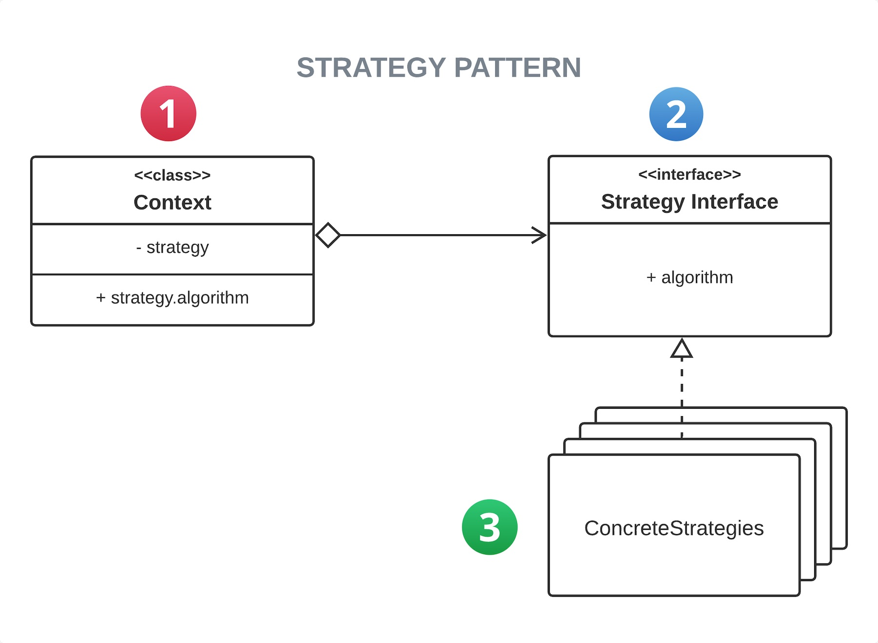
UML Diagrams
The following is the UML diagram of the Strategy pattern.
Context — It is the primary class of our application. It maintains a reference to one of the concrete strategies.
Strategy — Strategy interface is common to all supported strategies. Context can communicate with other strategies only through the strategy interface.
ConcreteStrategies — These are the classes that implement the algorithm using the Strategy interface.
Notes:
The while keyword indicates the use of the while loop.
A condition is checked.
If the condition evaluates to true, a block of commands (enclosed in braces) is executed.
When the program is done executing the block, the condition is checked again.
The block will be executed again and again, as long as the condition
evaluates to true.
As soon as the condition turns to false the block is skipped.

Slide 7
Implementation
Let's see the step-by-step process of implementing a strategy pattern.
You should first identify algorithms you want to execute as concrete strategies in the primary class.
Define the context (primary class) and add a reference to the strategy, a method to set the strategy, and another method to execute the strategy. You may also define a default strategy to switch between strategies only if they do not like the default one.
## context - the primary class class Context: strategy: Strategy ## the strategy interface def setStrategy(self, strategy: Strategy = None) -> None: if strategy is not None: self.strategy = strategy else: self.strategy = Default() def executeStrategy(self) -> str: print(self.strategy.execute())
Notes:
Syntax
while 'condition': //colons at the end of the line to determine the beginning of the loop scope
one or more commands //in a slight indentation to the right
…
The slight indentation to the right defines all the commands meant for repetition into a
repeating block called the loop block (also known as loop body).
Action
The loop continues to iterate as long as the value of the condition is true.
The condition is re-evaluated before each repetition of the loop block.
In this case the condition is (number < 1000) and the loop block is in lines 3-4.
Important
Consider a loop in action.
What makes it stop?
If the program is executing the code in the loop, will it do so “forever”?
For the program to eventually exit the loop the condition must be false at some point.

Slide 8
Implementation – cont’d
First, we define the strategy field for storing a reference to a strategy object, and two methods, setStrategy and executeStrategy. The setStrategy sets the strategy selected if a user selects an option, or else the default one.
3. Define the Strategy Interface, which is common to all the concrete strategies. The Strategy interface has an abstract method that you can alter in concrete strategies.
4.Define the concrete strategies which should implement the Strategy interface. These concrete strategies must have a common method that overrides the execute method of the Strategy interface.
from abc import ABC, abstractmethod ## Strategy interface class Strategy(ABC): @abstractmethod def execute(self) -> str: pass
## Concrete strategies class ConcreteStrategyA(Strategy): def execute(self) -> str: return "ConcreteStrategy A" class ConcreteStrategyB(Strategy): def execute(self) -> str: return "ConcreteStrategy B" class Default(Strategy): def execute(self) -> str: return "Default"
Notes:
The loop block (lines 3-7) consist of:
The commands the programmer wishes to repeat (lines 4-7)
Commands to make changes that will eventually turn the condition from true to false (line 7)
Now that we have the while loop in place, changing the number of times it is repeated (iterates) is very easy.
All we need to do is the change the condition (in this case, line 3) accordingly.
No change in the loop block is needed.

Slide 9
Implementation – cont’d
## Example application appA = Context() appB = Context() appC = Context() ## selecting stratigies appA.setStrategy(ConcreteStrategyA()) appB.setStrategy(ConcreteStrategyB()) appC.setStrategy() ## sets to default strategy ## each object below execute different strategy with same method appA.executeStrategy() appB.executeStrategy() appC.executeStrategy()
The output of the above code will be as follow:
ConcreteStrategy A
ConcreteStrategy B
Default
If you want to use another strategy, replace the ConcreteStrategy instance with the strategy you want. You can add a new concrete strategy without changing anything in the context.
Notes:
In line 8, the loop condition involves size which is known only during run-time.
Therefore, the programmer has no knowledge how many iterations will actually take place.
Question
How many iterations will the while repeat if 0 (zero) is entered as input for size (line 7)?
Answer
0 (zero) times.
This is because the while loop checks the condition counter <= size even before its first iteration.
Since the condition evaluates to false, there will not be even a single iteration of the loop.

Slide 11
Implementation – cont’d
## Changing the strategy among Rock, Paper, Scissors, and Random import random from abc import ABC, abstractmethod ## Strategy interface class Strategy(ABC): @abstractmethod def selection(self) -> None: pass ## Concrete strategies class Rock(Strategy): ## actual application will have the algorithm instead this method def selection(self) -> str: return "Rock" class Paper(Strategy): def selection(self) -> str: return "Paper" class Scissors(Strategy): def selection(self) -> str: return "Scissors" class Random(Strategy): def selection(self) -> str: options = ["Rock", "Paper", "Scissors"] return random.choice(options)
Notes:
In line 8, the loop condition involves size which is known only during run-time.
Therefore, the programmer has no knowledge how many iterations will actually take place.
Question
How many iterations will the while repeat if 0 (zero) is entered as input for size (line 7)?
Answer
0 (zero) times.
This is because the while loop checks the condition counter <= size even before its first iteration.
Since the condition evaluates to false, there will not be even a single iteration of the loop.

Slide 12
## Context class class Game: strategy: Strategy def __init__(self, strategy: Strategy = None) -> None: if strategy is not None: self.strategy = strategy else: self.strategy = Random() def play(self, sec) -> None: s1 = self.strategy.selection() s2 = sec.strategy.selection() if s1 == s2: print("It's a tie") elif s1 == "Rock": if s2 == "Scissors": print("Player 1 wins!") else: print("Player 2 wins!") elif s1 == "Scissors": if s2 == "Paper": print("Player 1 wins!") else: print("Player 2 wins!") elif s1 == "Paper": if s2 == "Rock": print("Player 1 wins!") else: print("Player 2 wins!") ## Example application ## PLayer 1 can select his strategy player1 = Game(Paper()) # Player 2 gets to select player2 = Game(Rock()) # After the second player choice, we call the play method player1.play(player2)
Notes:
In line 8, the loop condition involves size which is known only during run-time.
Therefore, the programmer has no knowledge how many iterations will actually take place.
Question
How many iterations will the while repeat if 0 (zero) is entered as input for size (line 7)?
Answer
0 (zero) times.
This is because the while loop checks the condition counter <= size even before its first iteration.
Since the condition evaluates to false, there will not be even a single iteration of the loop.

Slide 13
Conclusion
In this article, you have seen where and how to use the strategy pattern in your code. You can build flexible and maintainable software applications using the strategy pattern. You can switch between algorithms at runtime according to the user's decision without changing the code. But if your code only has a couple of algorithms, there is no need to use strategy. It just makes your code look complex with numerous classes and objects.
The Strategy pattern can work as an alternative for conditional statements for selecting the behavior of the application. But the potential drawback of strategy pattern is that the users must know how strategies differ from each other to select what they need. So it would be best if you use the strategy pattern only when the variation in behavior of the application is relevant to the users. So try to make your software applications flexible using the strategy pattern.
Notes:
In this example, a while loop is used for input-range check.
The calculation that starts in line 3 assumes that the score is within a certain range (0..100).
What if the input (line 2) is outside that range, say score = -5?
What is the meaning of line 6 then?
In order to validate the intended processing which starts in line 7, we use the while loop (lines 4-6) to repeatedly receive inputs as long as it is invalid.

Slide 14
Additional information
Cohesion and coupling: write BETTER PYTHON CODE Part 1
https://www.youtube.com/watch?v=WQ8bNdxREHU
Cohesion & Coupling in Python
An Explanation of the Two Important Quality Metrics in OOP
https://auth0.com/blog/strategy-design-pattern-in-python/#:~:text=Strategy%20pattern%20follows%20the%20Open,flexible%20and%20easy%20to%20maintain.
Notes:
Notice that
the loop block (lines 3-5) contains only program-related commands and no loop-related command. This way, we won’t accidentally omit to increment the counter or perform any other loop-related statements.
"i" is initialized in the loop header (line 2). Therefore it does not need to be initialized in a declaration.
In that case, i will be unrecognized when used outside the loop
(compile-time error).
Q: Why does result need to initialized upon declaration (line 6)?

